Slide 1



Introduction to IS project
Innovation team
Abanoub bekhiet abd allah
Arsany ehab fowzy
Ahmed asfour alsayed
Remon zarif

Slide 2

School data base
DR.Asmaa saad
ENG.Ahmed abd elsalam
Under supervision

Slide 3
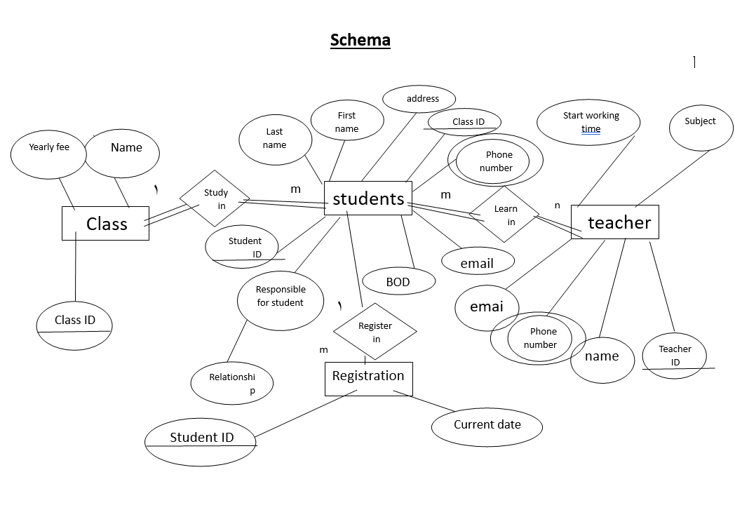
Entity Relationship Diagram

Slide 4
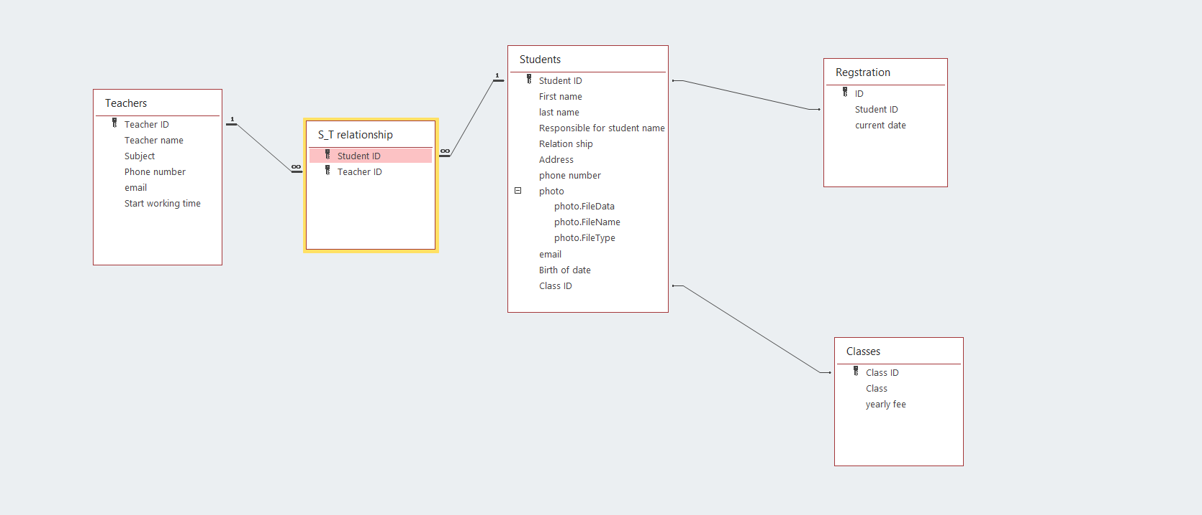
schema

Slide 5
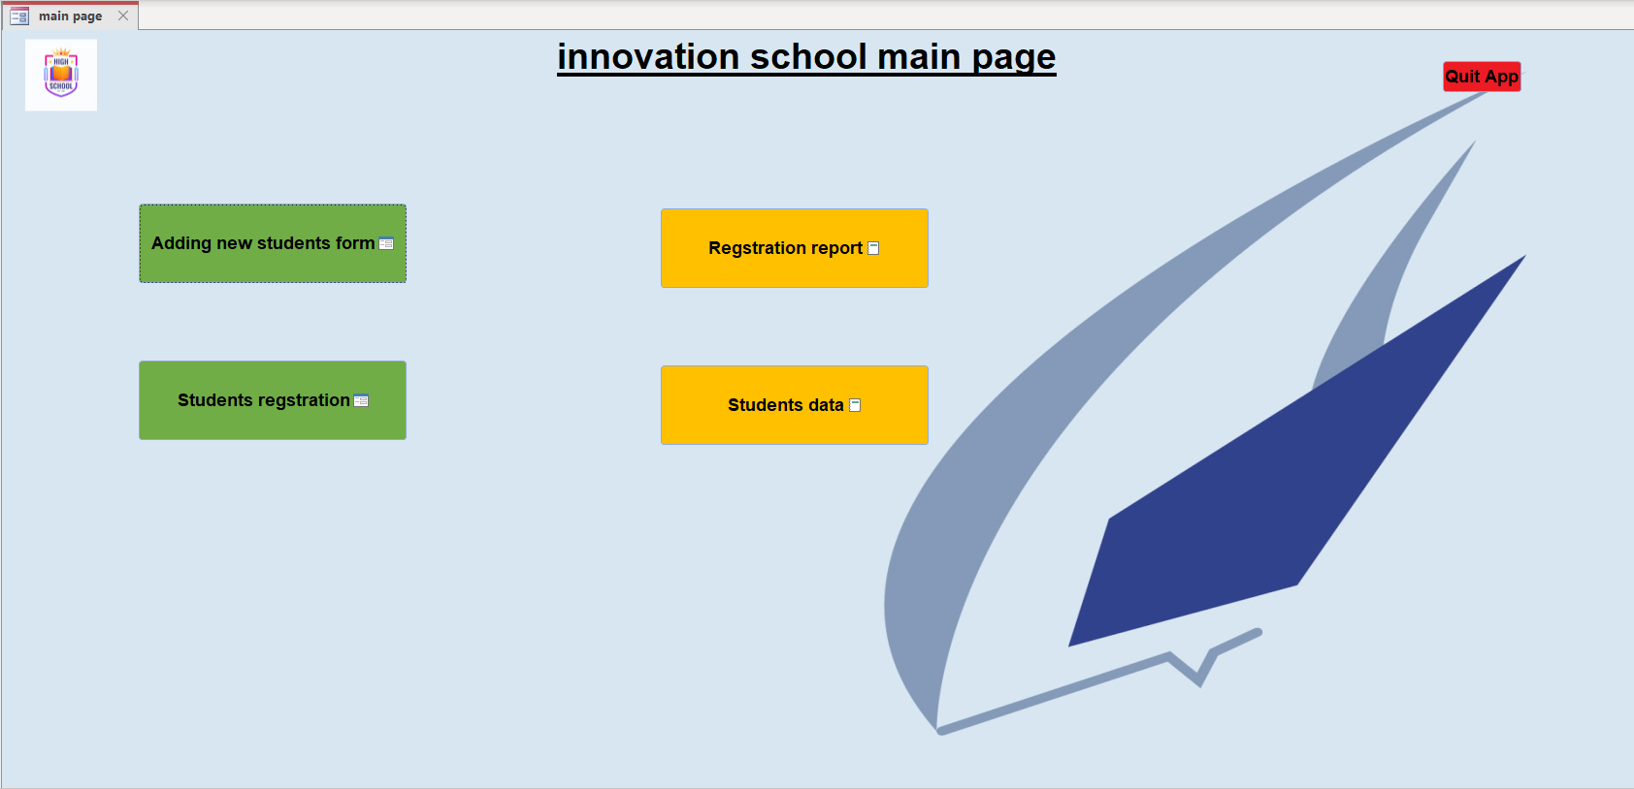
The main page of the system that is opened automatic by the macro
Consists of four buttons that lead to forms and reports

Slide 6
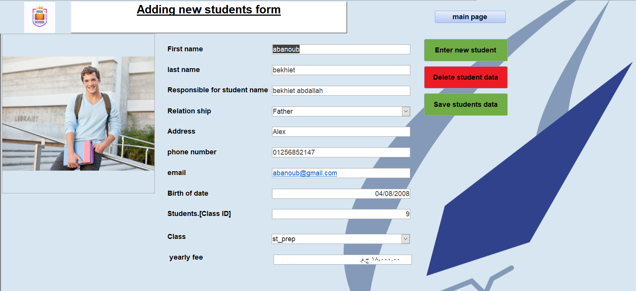
The form that
With it we can Write down students' information
Have three buttons to save and delete and enter new student

Slide 7

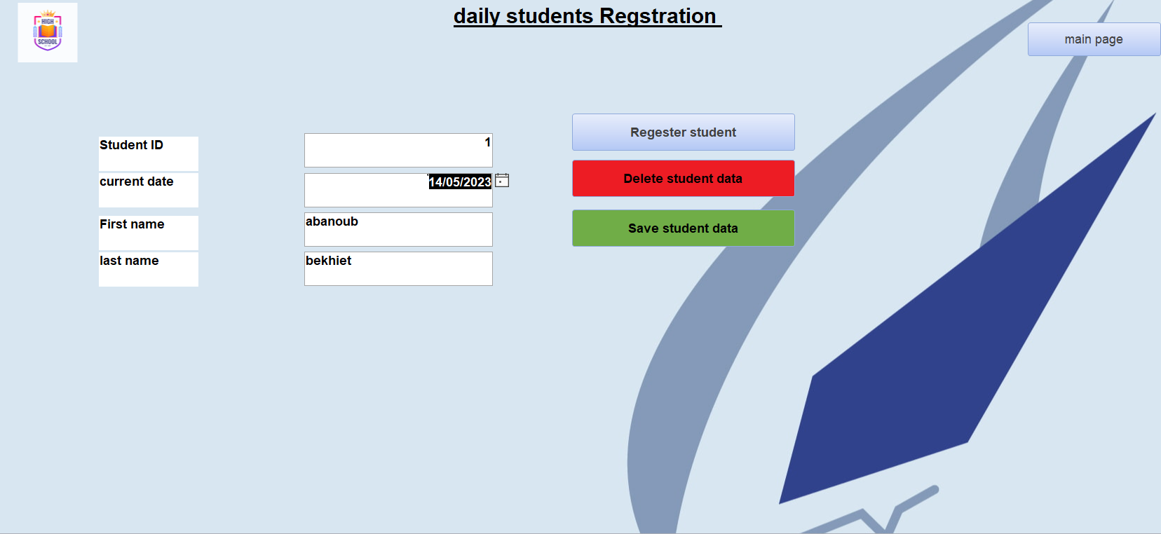
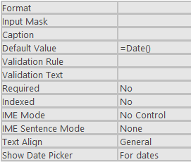
Third form that enter students' attendance with three buttons one save ,one delete, and one enter new student attendance
By adding the date of the current day

Slide 8
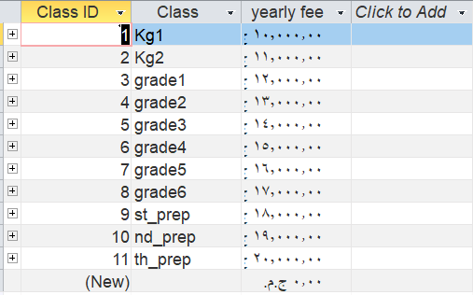
Classes table that indicates for the yearly fee for each class
and each class have specific yearly fee

Slide 9
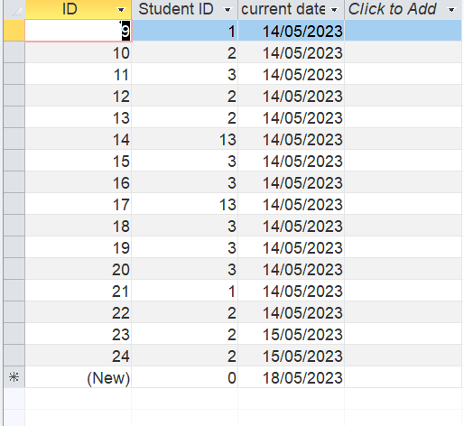
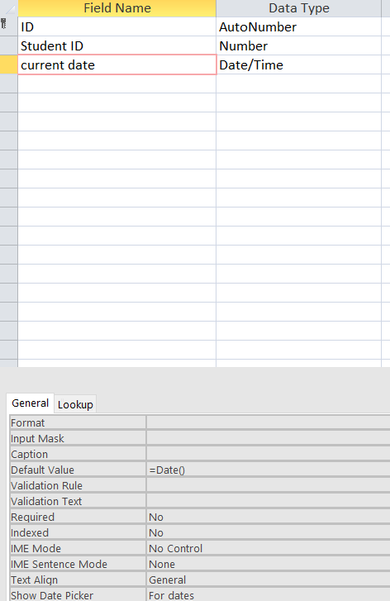
Registration table that has students' attendance every time student register in the registration form the attendance of the student will be write down in this table

Slide 10
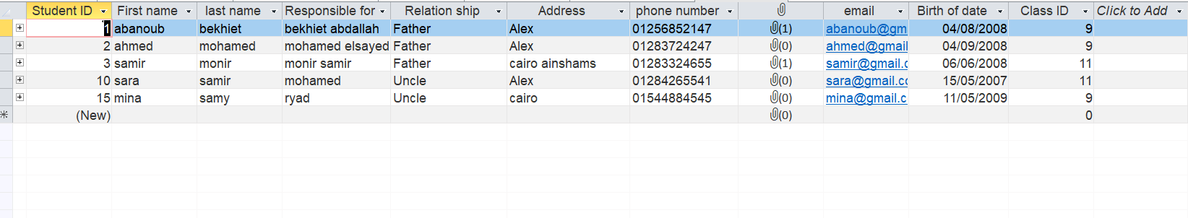
third table consists of
First and last name
Responsible for child and relation ship
Address
Phone number and picture for child and email
Etcetera

Slide 11
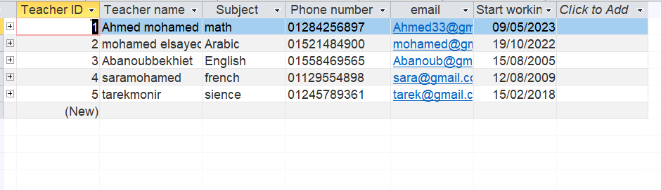
Fourth table consists of teacher's information
the name
Subject that teachers teaches
phone number
Email
Start working time of the teacher

Slide 12
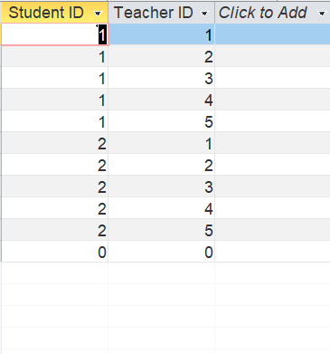
The end table that links the many to many relationship and divide it to two one to many relationships

Slide 13
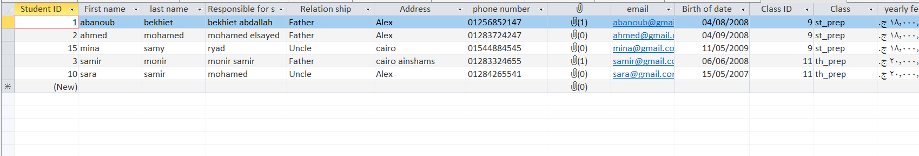
The first query of the system that collect some columns from two tables (classes table and student’s data table ) we make this query to receive the student's information by the student's data form.

Slide 14
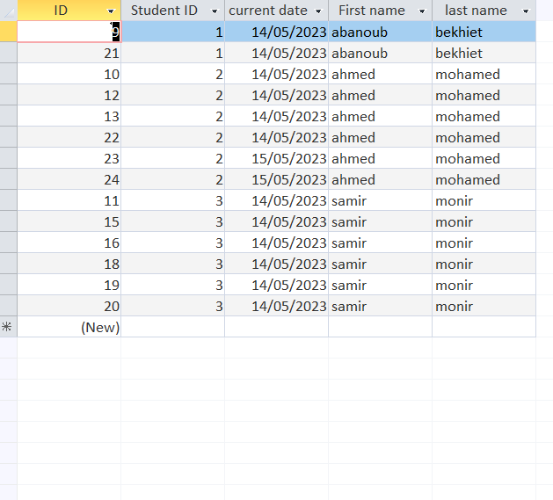
Second query is called registration query is made by columns from student's data table and registration table and we made it to receive students' attendance from students' registration form

Slide 15
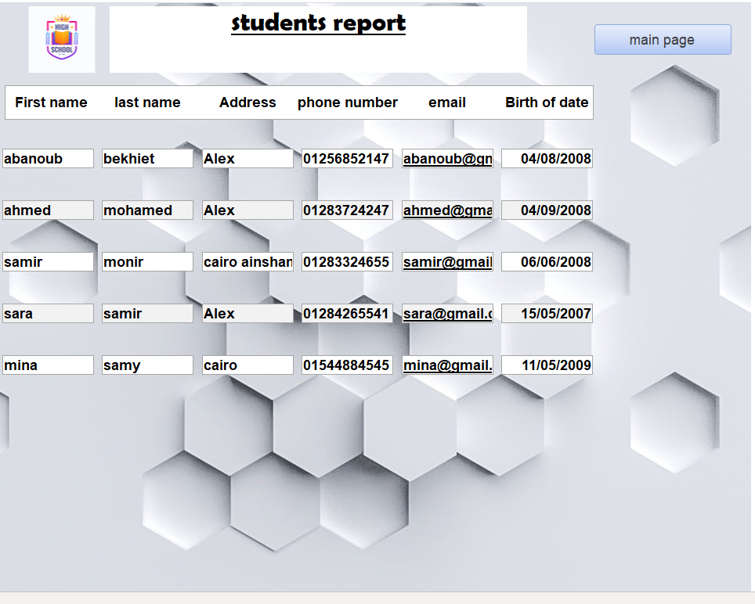
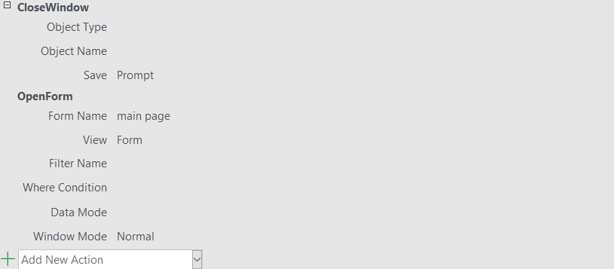
Student's data report that show students information
The main page button transport you to main page and close students' data report and we make this operation by macro

Slide 16
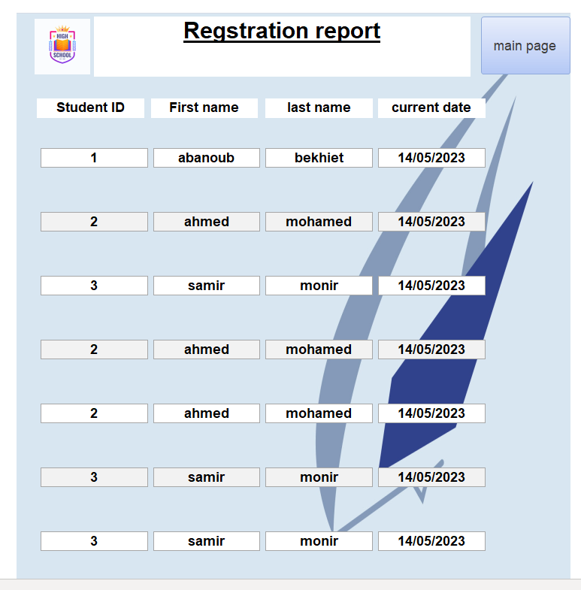
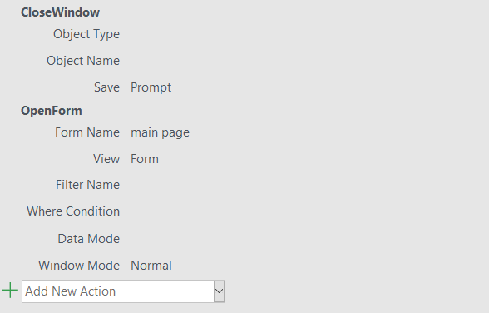
Second report that show students attendance that links with student's registration query and main page button transport you to main page and close current page

